Slide 1
Kick-Off Meeting
Sol. W9124D-23-R-0007
Information Technology Support Services (ITSS), U.S. Army Recruiting Command
Proprietary and Confidential - HunaTek

Slide 2
Short Turn-Around
Proposals are due October 27, 2022 09:00 a.m. ET

Slide 3
Agenda
Team Composition
Schedule
Opportunity Overview
Proposal Development
Action Items
Discussion & Questions

Slide 4
Team Composition
Teaming Partners | Contact Person | email

Slide 5
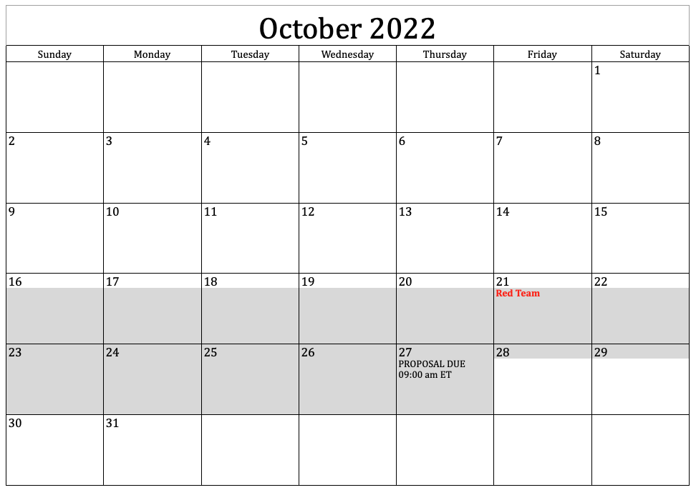
Schedule

Slide 6
Opportunity Overview
Information Technology Support Services (ITSS), U.S. Army Recruiting Command, Fort Knox, KY (USAREC)
Enterprise-Wide Strategic Sourcing vehicle providing professional support services, provide a department-wide vehicle for a broad range of general management and business support services and solutions
USAREC is at the center of the Army's initiative to mold military personnel functions into an improved structure, enabling efficient and effective management of accessioning Army active duty and ReserveSoldiers worldwide. USAREC’s focus is on the integration and coordination of military personnel accessioning systems and to develop/optimize and provide the strength of Army accessioning in peacetime and war. The Command performs all accessioning functions for the distribution, development, and transition to Active duty, including Reserve Soldiers. The primary location of the accessioning mission is Fort Knox, KY; with a small number of resources in several locations in the Continental U.S. (CONUS) and Outside the Continental U.S. (OCONUS) locations. The footprint of the accessioning mission is worldwide.

Slide 7
Opportunity Overview
Continued
..

Slide 8
Opportunity Overview
Continued
..

Slide 9
Proposal Development
Kick-off - Today!
Contacts
Schedule
Outline, Writing Assignments
Data Call(s)
Review Team (Red, Gold)

Slide 10
Some Notes on the Proposal

Slide 11
Action Items
Update Contacts for Technical and Pricing
Data Call #1
“Pink” version outline

Slide 12
Discussion & Questions
Keith R. Nicoletti Director of Business Development keith.Nicoletti@hunatek.com tel (571) 241-7516
Tom Termini termini@bluedog.net tel 301-649-5000

